Slide 1
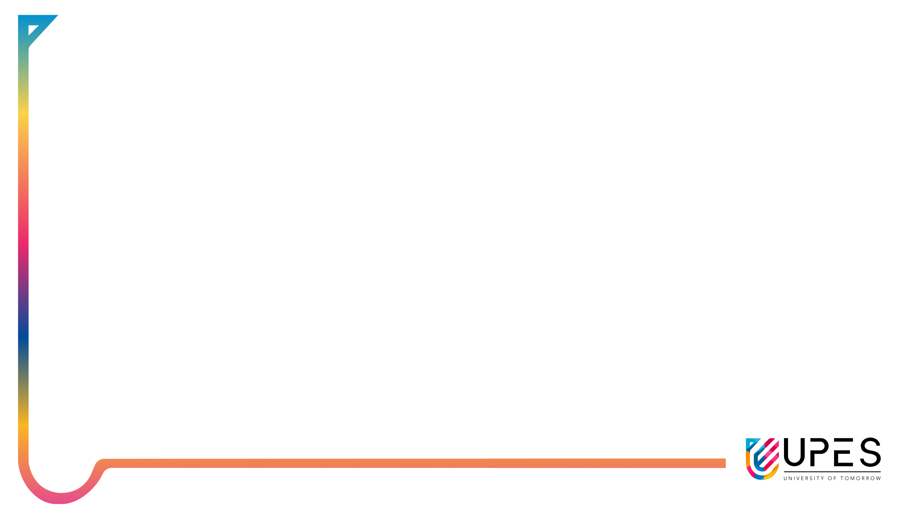


Applied Machine Learning
Assignment I
Submitted to:
Dr. Tanupriya Choudhary
Submitted by :
Rajkumar Pandey SAP : 590011165

Slide 2
Q-1: what type of ML algorithm used in a dataset how to find it out ?
Ans: Identifying the type of machine learning (ML) algorithm used for a given dataset requires understanding the dataset’s characteristics, the problem it aims to solve, and the nature of its target variable.
Understand the Problem:
Supervised Learning: Classification (e.g., spam detection) or Regression (e.g., house prices).
Unsupervised Learning: Clustering (e.g., customer segmentation) or Dimensionality Reduction (e.g., PCA).
Reinforcement Learning: Learn by interaction (e.g., game playing).
Analyze the Dataset:
Structured Data: Use Decision Trees, Random Forests, or Linear Regression.
Unstructured Data: Use CNNs (images), RNNs (text), or Transformers.
Small Dataset: Use simpler models (e.g., Logistic Regression).
Large Dataset: Use complex models (e.g., Deep Learning).
Numerical Features: Use Linear Regression, SVM, or Neural Networks.
Categorical Features: Use Decision Trees, Random Forests, or XGBoost.
Labeled Data: Use supervised learning.
Unlabeled Data: Use unsupervised learning.

Slide 3
3.Choose the Algorithm:
Classification: Logistic Regression, Decision Trees, Random Forests, SVM, Neural Networks.
Regression: Linear Regression, Ridge Regression, Random Forests, XGBoost.
Clustering: K-Means, DBSCAN, Gaussian Mixture Models.
Dimensionality Reduction: PCA, t-SNE, Autoencoders.
Anomaly Detection: Isolation Forest, One-Class SVM.
Recommendation Systems: Collaborative Filtering, Neural Networks.
4.Evaluate and Iterate:
Split data into training and testing sets.
Train the model and evaluate performance (e.g., accuracy, RMSE).
Refine the model by tuning hyperparameters or trying different algorithms.

Slide 4
Q-2: What is the difference between hinge loss and triplet loss explain with an example?
nature | Triplet Loss | Hinge Loss
Purpose | Used in metric learning to ensure that similar samples (anchor-positive) are closer together while dissimilar ones (anchor-negative) are farther apart. | Used in classification tasks (mainly for SVMs) to maximize the margin between positive and negative classes.
Formula | max(d(A,P)−d(A,N)+margin,0) where A is the anchor, P is the positive sample, and N is the negative sample. | max(0,1−yf(x)) where y is the true label (+1 or -1), and f(x) is the predicted score.
Key Concept | Minimizes the distance between similar points while pushing apart dissimilar ones. | Ensures a minimum margin between classes in classification.
Usage | Used in face recognition, metric learning, and embedding learning. | Common in Support Vector Machines (SVMs) for classification.
Hyperparameter | Requires a margin hyperparameter to define the minimum separation between positive and negative pairs. | Uses a margin (1 by default) in SVMs to define the separation boundary.

Slide 5
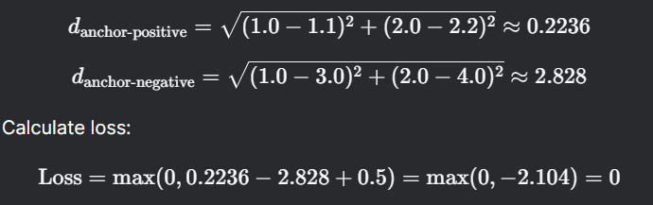
Hinge loss:
Hinge Loss = max⁡(0,1 − y ⋅ y^)
Y : True label (+1 or −1).
y^​: Raw Predicted score (not probability).
Example:
True label (y): (+1 or –1)
Predicted score (y^​): 00.8
Hinge Loss:
Hinge Loss = max⁡(0,1−(1⋅0.8))=max⁡(0,0.2)=0.2
Triplet loss:
Triplet Loss=max(0,d(a,p) − d(a,n) + margin)
p: Positive example (same class as anchor).
n: Negative example (different class from anchor).
d(⋅): Distance metric (e.g., Euclidean distance).
a: Anchor example
Example:
Anchor (a): [1.0,2.0]
Positive (p): [1.1,2.2]
Negative (n): [3.0,4.0]
Margin: 0.5

Slide 6
Q-3:what do you mean by training, testing and validation of data showcase with help of python programming example?
Ans: Training Data:
This is the actual dataset from which a model trains .i.e. the model sees and learns from this data to predict the outcome or to make the right decisions.
Most of the training data is collected from several resources and then preprocessed and organized to provide proper performance of the model.
Type of training data hugely determines the ability of the model to generalize .i.e. the better the quality and diversity of training data, the better will be the performance of the model. This data is more than 60% of the total data available for the project.
Testing Set:
This dataset is independent of the training set but has a somewhat similar type of probability distribution of classes and is used as a benchmark to evaluate the model, used only after the training of the model is complete.
Testing set is usually a properly organized dataset having all kinds of data for scenarios that the model would probably be facing when used in the real world If the accuracy of the model on training data is greater than that on testing data then the model is said to have overfitting.
This data is approximately 20-25% of the total data available for the project.

Slide 7
Validation set:
The validation set is used to fine-tune the hyperparameters of the model and is considered a part of the training of the model.
Validation dataset can be utilized for regression as well by interrupting training of model when loss of validation dataset becomes greater than loss of training dataset .i.e. reducing bias and variance.
This data is approximately 10-15% of the total data available for the project but this can change depending upon the number of hyperparameters .i.e. if model has quite many hyperparameters then using large validation set will give better results.
Now, whenever the accuracy of model on validation data is greater than that on training data then the model is said.

Slide 8
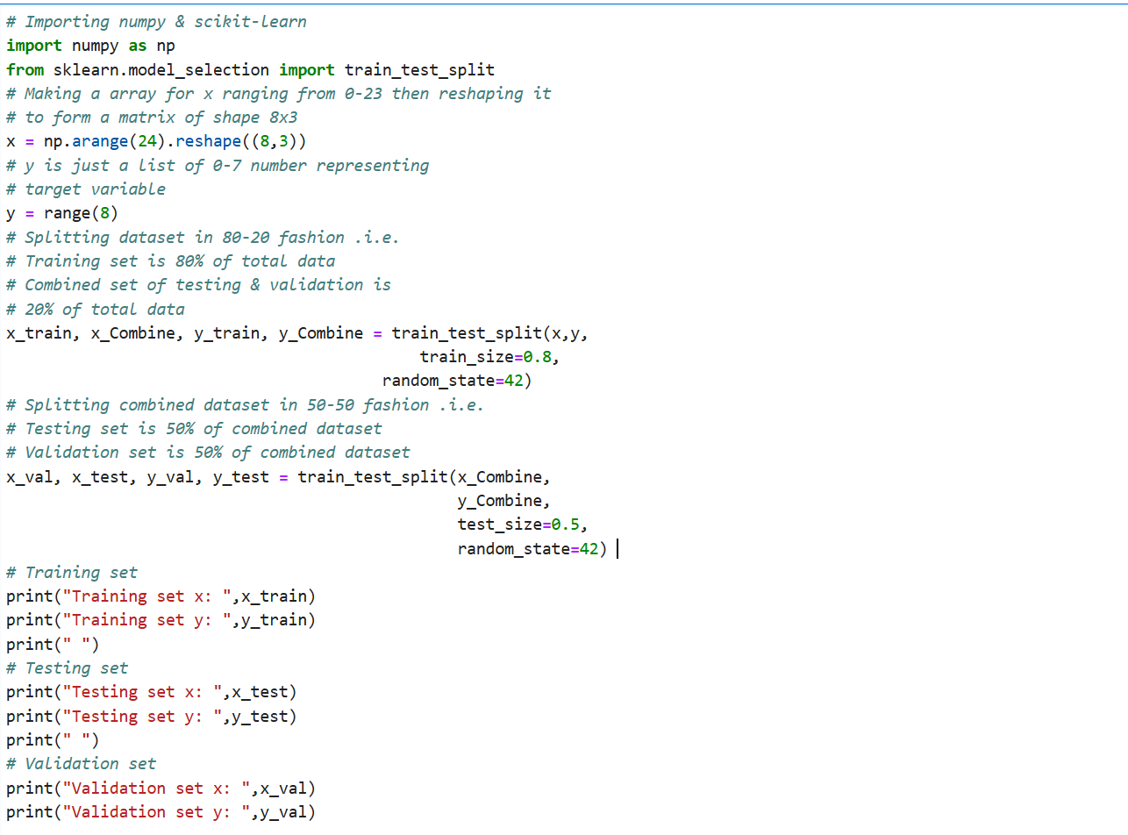

Slide 9
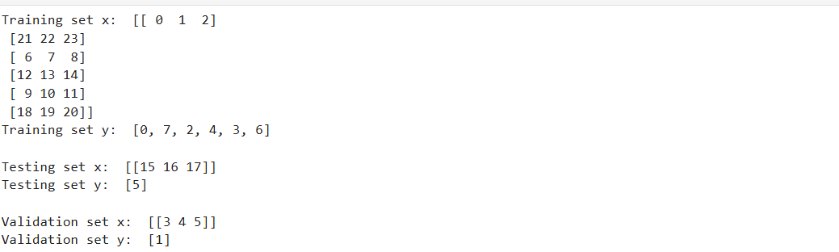

Slide 10
Q-4 what is the use of training & testing of data and in training and testing how random operator can be used?
Ans: In machine learning, the process of training and testing data is essential for building and evaluating models.
Training Data:
Purpose: Training data is used to teach the model to identify patterns, relationships, or features within the data. The model learns by adjusting its parameters (e.g., weights in a neural network) to reduce errors.
Use: The model "learns" from the training data to make predictions or decisions.
Testing Data:
Purpose: Testing data is used to evaluate the model's performance on unseen data. It helps determine how well the model generalizes to new inputs.
Use: The model's predictions on the testing data are compared to the actual values to measure accuracy, precision, recall, or other performance metrics.
Why Split Data into Training and Testing Sets?
Prevent Overfitting: If a model is trained and evaluated on the same data, it may perform well on that data but fail to generalize to new, unseen data. Splitting the data ensures the model is tested on data it has never encountered.

Slide 11
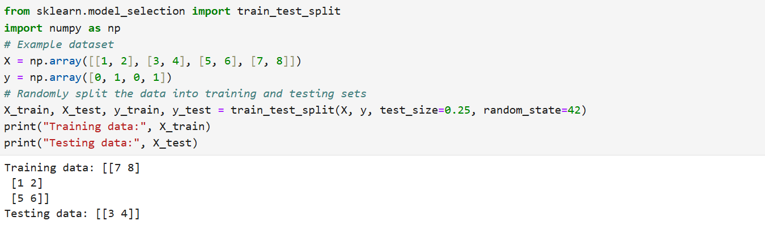
Role of random operator in training and testing:
A random operator is often used in the process of splitting data into training and testing sets.
Random Splitting: Divides data into training/testing sets fairly.
Reproducibility: Fixed seed (e.g., random_state=42) ensures consistent results.
Prevents Bias: Avoids skewed splits from ordered data.
Cross-Validation: Randomly creates subsets for robust evaluation.
Parameter Initialization: Randomly sets model weights to avoid poor optima.
Fair Testing: Ensures unbiased evaluation on unseen data.
Code:

Slide 12
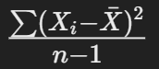
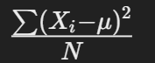
Q-5 What is the difference between sample and population variance share with the help of equation and example.
Aspect | Sample Variance ( s² ) | Population Variance ( σ² )
Definition | Measures the variance of a sample (subset of data) from a population. | Measures the variance of an entire population (all data points).
Formula
Mean Used | Sample mean (xˉ) | Population mean (μ)
Denominator | n − 1 (degrees of freedom) | N (total number of data points)
Purpose | Estimates the population variance from a sample | Measures the true variance of the population
Bias Adjustment | Dividing by n − 1 corrects the bias in estimation | No bias adjustment needed, uses entire population data
Usage | When only a subset of the population is available | When the entire population data is available
Data Set | Sample data (a subset of the population) | Population data (all data points in the population)

Slide 13
Example
Dataset
Consider the following dataset representing the ages of 5 people in a small town (population):
Ages={25,30,35,40,45}
Population Variance:
Calculate the population mean (μ):
μ=(25+30+35+40+45)/​5 = 35
2.Calculate squared deviations from the mean:
(25−35)^2=100, (30−35)^2=25, (35−35)^2=0, (40−35)^2=25, (45−35)^2=100
3.Sum the squared deviations:
100+25+0+25+100=250
4.Divide by N (population size):
σ2=250/5=50
Sample Variance:
Now, assume we take a sample of 3 ages from the population:
Sample Ages={25,30,35}
xˉ=(25+30+35)/3=30
2.Calculate squared deviations from the mean:
(25−30)^2=25,(30−30)^2=0,(35−30)^2=25
3.Sum the squared deviations:
25+0+25=50
4.Divide by n−1 (sample size minus 1):
S2=50/(3−1)=25

Slide 14
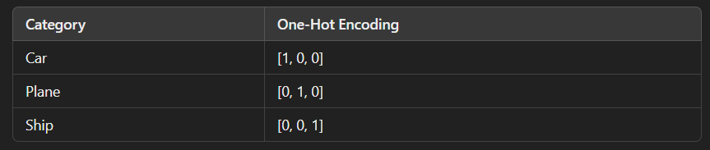
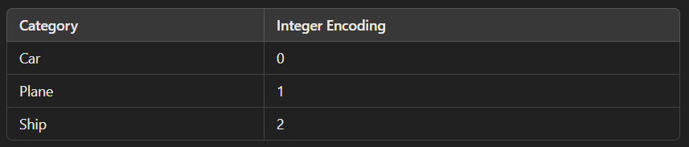
Q-6:in the loss function what is the meaning of one hot encoding and integer encoding?
Ans:
One-Hot Encoding:
One-hot encoding converts categories into binary vectors, where each category is represented as a vector of 0s and 1s
How it is Used in Loss Functions?
With One-Hot Encoding:
The model outputs probability distributions using softmax activation.
The cross-entropy loss function compares the predicted probabilities with the actual one-hot encoded labels.
Example: Consider a dataset with three classes: Car, Plane, Ship
Integer Encoding
Integer encoding assigns a unique integer to each category.
How it is Used in Loss Functions?
Typically used with sparse categorical cross-entropy, which converts integer labels to one-hot internally.
Example: Consider a dataset with three classes: Car, Plane, Ship

Slide 15
Q-7 In ml what do mean by overfitting of a model and how we are dealing with overfitting show case with the help of the python programming
ANS: Overfitting: Overfitting happens when a machine learning model learns the noise in the training data instead of the actual pattern.
This leads to:
High accuracy on the training data
Poor performance on new/unseen data
Example Scenario:
A student memorizes answers instead of understanding concepts. They score well in practice exams but fail real tests with new questions.
How to deal with overfitting:
1.Train with More Data – Helps the model learn general patterns instead of memorizing.
2. Cross-Validation – Splitting the dataset into multiple parts (e.g., K-Fold Cross-Validation).
3. Regularization – Techniques like L1 (Lasso) and L2 (Ridge) Regularization add penalty terms to prevent overfitting.
4. Dropout (For Neural Networks) – Randomly deactivates some neurons during training.
5. Pruning (For Decision Trees) – Removing less important branches.
6. Early Stopping – Stops training when validation loss starts increasing

Slide 16
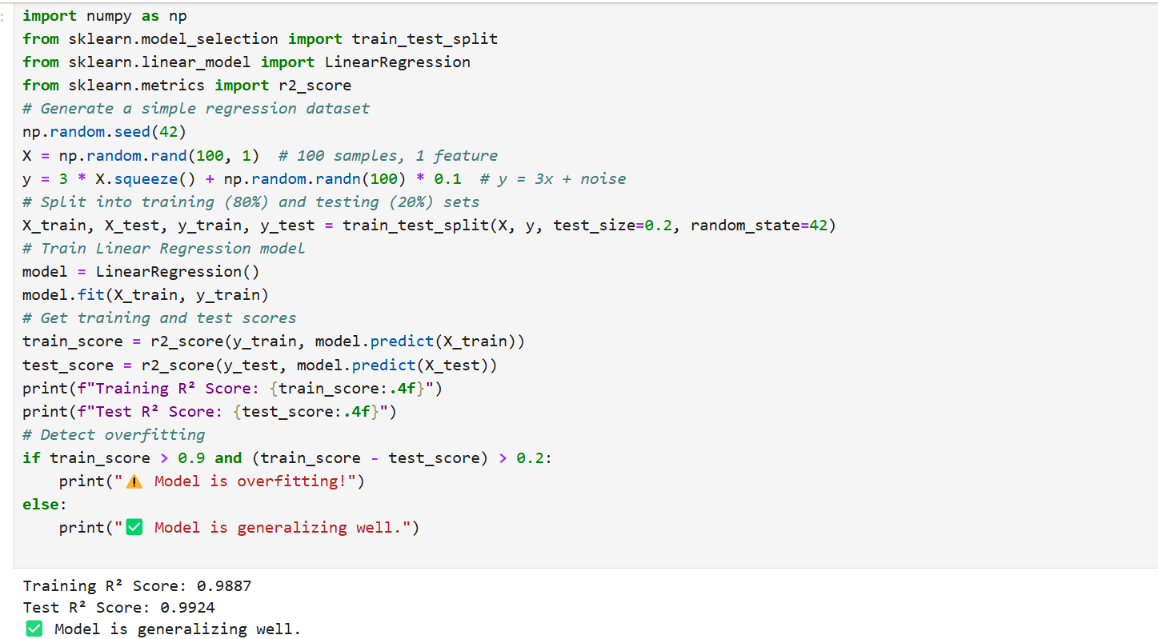
Code:

Slide 17
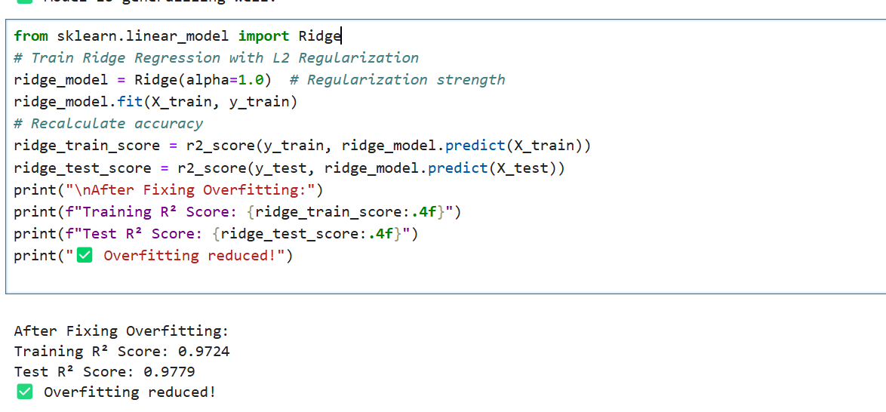

Slide 18
Q-8 How to handle noisy data and also what do you mean by Imbalance data showcase with example in python programming. What type of measurement we will be taking to handle the data set.
Ans: 1.Noisy Data: Noisy data contains errors, outliers, or irrelevant information that can mislead machine learning models.
How to Handle Noisy Data?
Smoothing Techniques – Use moving averages, Gaussian filters, or regression models.
Outlier Detection & Removal – Methods like Z-score, IQR, or Isolation Forest.
Data Cleaning – Fix missing values using mean imputation or interpolation.
2.Imbalanced Data:
Imbalanced data occurs when one class significantly outnumbers the other(s) in a classification problem. This can lead to biased models that favor the majority class.
How to Handle Imbalanced Data:
Resampling:
Oversampling: Increase the number of minority class samples (e.g., using SMOTE).
Undersampling: Reduce the number of majority class samples.
Class Weights:
Assign higher weights to the minority class during model training.
Algorithm Selection:
Use algorithms that handle imbalanced data well (e.g., Random Forests, Gradient Boosting).
Evaluation Metrics:
Use metrics like F1-score, Precision-Recall Curve, or AUC-ROC instead of accuracy.

Slide 19
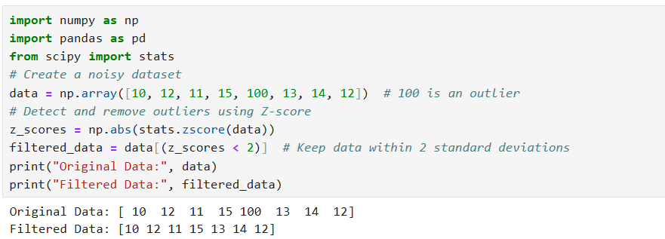
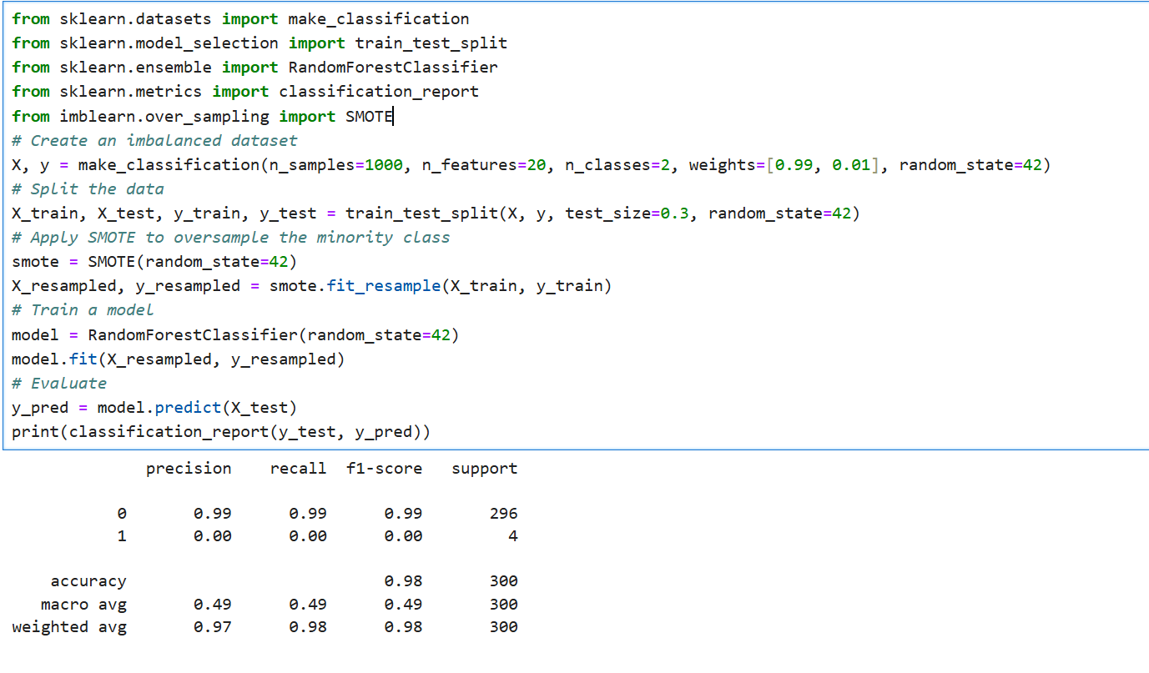
Code:
Noisy data:
Imbalance data:

Slide 20
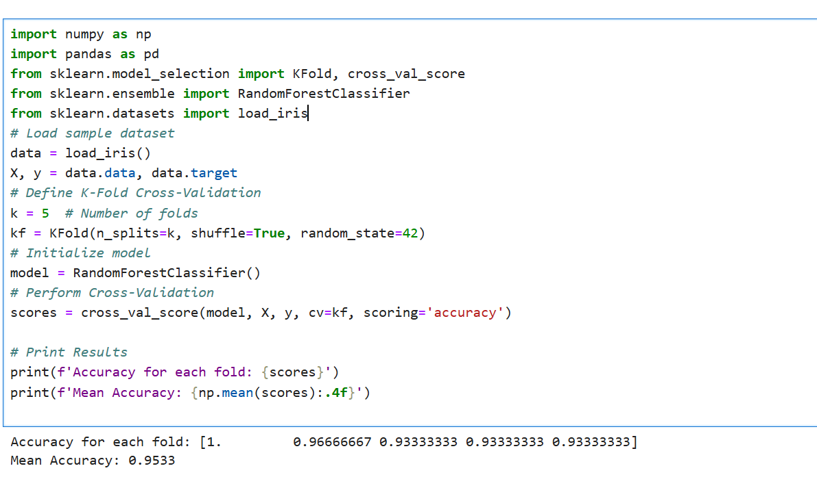
Q-9: Share with the example of k-fold cross validation technique. you may take k with any number like 5,10,20,30.
ANS: K-Fold Cross-Validation is a technique used to evaluate the performance of a machine learning model. It divides the dataset into k subsets (folds), trains the model on k-1 folds, and validates it on the remaining fold. This process is repeated k times, with each fold used exactly once as the validation set. The final performance is the average of the results from all folds.
Why use it?
Prevents overfitting
Ensures better model evaluation
Useful when data is limited
steps of K-Fold Cross-Validation
Split the dataset into k equal parts (folds).
For each fold:
Train the model on k-1 folds.
Validate the model on the remaining fold.
Calculate the average performance across all folds.

Slide 21
Q-10:What is the difference between dimensionality reduction and dimensionality addition? Share a case study using the PCA algorithm.
Ans:
Aspect | Dimensionality Reduction | Dimensionality Addition
Definition | Reduces the number of features (dimensions) in the dataset while retaining important information. | Increases the number of features by creating new ones, often through feature engineering.
Purpose | Simplifies the dataset, reduces noise, and improves computational efficiency. | Enhances the dataset by adding meaningful features to improve model performance.
Techniques | PCA, t-SNE, LDA, Autoencoders, etc. | Polynomial features, interaction terms, domain-specific feature creation, etc.
Use Case | High-dimensional data (e.g., images, text) where reducing dimensions is necessary. | Low-dimensional data where additional features can provide more insights.
Impact on Model | Speeds up training, reduces overfitting, and improves interpretability. | Can improve model accuracy by capturing complex relationships in the data.

Slide 22
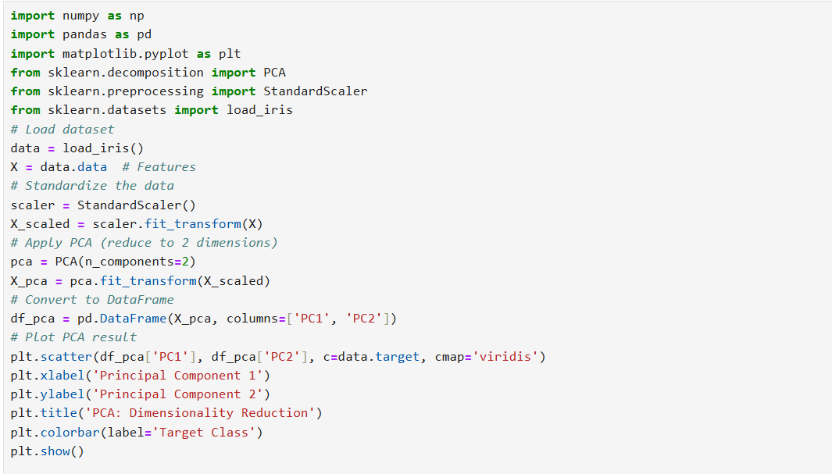
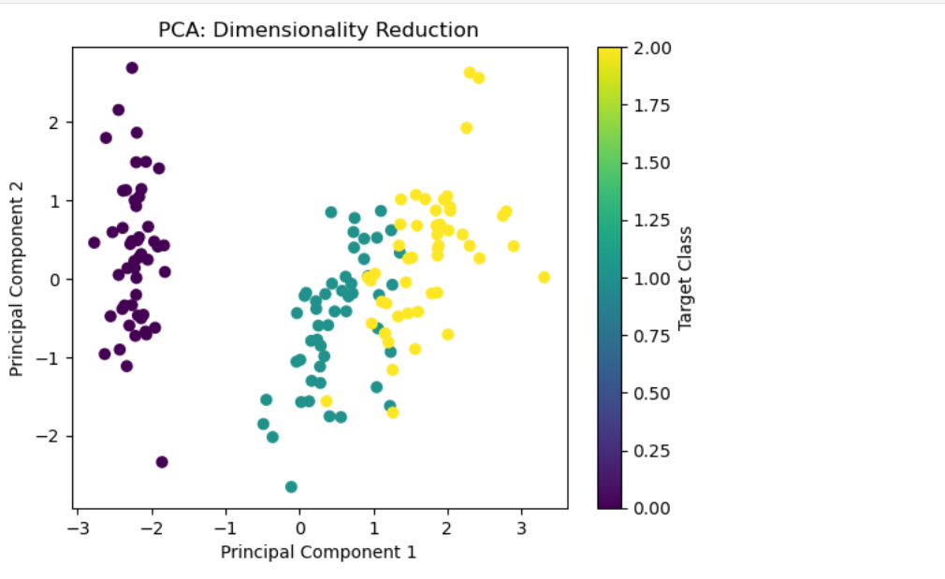
Case Study: Using PCA for Dimensionality Reduction
Scenario: We have a dataset with 10 features, and we want to reduce them to
2 principal components while maintaining most of the variance.

